Slide 1
Network Performance
Problem diagnosis
Performance enhancement
Baseline measurements
  introduction of new service
Notes:
In this lecture we will look at network performance.
There are several reasons for doing this both as a design issue and a measurement issue.
The simplest is fault finding. If the network seems to be responding very slowly it would be useful to have some idea of where the problem is located.
Another obvious application is performance enhancement. There are many parameters which affect the overall performance of a network. In order to tune these it is necessary to have a good measurement of network performance.
When introducing new services it can be useful to make measurements before (baseline) and after the service to determine the impact on network performance.
One of the key properties affecting network performance is design. The design not only involves the obvious physical properties such as bandwidth, topology and processing speed but also the implementation of the protocols in software can have a major impact.

Slide 2
Measurement cycle
Decide what you want to measure
Change one parameter
Does it make sense?
Measure it
Notes:
Here we review the basic cycle of measurement. The starting point is to decide what you want to measure. Whatever it is, it needs to be a good indicator of the performance that you are trying to measure or optimise.
Having decided what the quantity is to measure we then need to work out how that is to be done and to make the measurement.
Now we have a measurement it is a good idea to check to see if the measurements make any sense. A number of things can go wrong:
The measurements may be dominated by noise.
The measurement may not measure what you think it does.
The measurement is correct but your original understanding is wrong.
Having reached a point where you are satisfied that the measurement is useful you can now change some system parameter and see what effect it has. At this point you may run into another problem which is that the conditions in the network may have changed between the two measurements.

Slide 3
Sampling
Sample size
  need to build up statistics
  beware of slow changes in network condition
  beware of rare events
diurnal changes
  network use changes throughout the day
  night is not necessarily a ‘quiet’ time
  what is a typical result
Resolution
  fast events need a fine grained clock
Notes:
As with any measurement we need to take care of our measurement statistics. Remember that if E is the (random) error on a single measurement then the error on N measurements is E/sqrt(N). There can also be systematic errors such as the overhead involved in a call to a system time function. In order to achieve good statistics we need to use large N. However, we must be careful not to use such a large N that the quantity we are trying to measure is changing over the course of the measurements. We also need to be aware of rare events such as a router crashing and rebooting during a measurement.
Networks have diurnal (daily) changes resulting from the normal work patterns of users and processes. Do not be tempted tot assume night is a quiet time as backups and database downloads are often performed during the night. We might want to measure some aspect of network performance under ‘typical’ conditions but even that is difficult to define. Even in an office there are some atypical events such as re-installing some software over the network.
Measurement resolution is always a problem. If we are measuring a fast event we need to ensure that the system clock has sufficient resolution to make the measurement meaningful.

Slide 4
Caching
used to enhance network performance
  store recently accessed data locally
  can lead to changes in what you are measuring
Buffering
  Remember TCP and UDP may not send data as soon as it is handed over from an application
  Congestion can cause changes in time spent in buffers from one measurement to the next
Notes:
Caching is a useful technique which can enhance network performance. Recently accessed data can be stored locally so that future accesses are speeded up. However, this can also cause problems with making measurements if a file is once accessed remotely and then from a local cache.
Buffering can also cause problems. Remember that both TCP and UDP are allowed to buffer data internally before ever sending it out onto the network. Also, buffers in the network routers can lead to random times spent in them as congestion comes and goes.

Slide 5
Extrapolation
generally non-scientific
  practitioners should be burnt at the stake
quiescent measurements don’t extrapolate
  congestion e.g. ALOHA throughput
  queueing theory delays
Notes:
Extrapolation is just about the most dangerous and unscientific game to play. In the absence of an underlying theory, results taken over some range of the dependent variable tell you nothing about the results outside the range. Even if we have a theory, it must have been tested under the conditions that apply in order to allow us to fit parameters and use the analytic formula for the extrapolation.
Note, fitting some results to a polynomial or other randomly chosen fitting function does NOT constitute a theory; not now, not ever, NEVER.
Always beware of making extrapolations based on quiescent systems. Remember the performance of pure and slotted ALOHA is the same under small loads. However, their peak throughput is significantly different. Even if you were operating an ALOHA protocol, remember that the simple theory for the throughput makes assumptions about the statistics of the packet arrival times. If, for some reason, the packets on your network don’t have those statistics the performance would be different.
Queueing also has a load dependent effect on systems. Factors of 1/(1-L) occur where L is the load.

Slide 6
Design
Rules of thumb collected by Mogul
Rule 1
  CPU speed is more important than network speed
    caused by software overhead of protocol stack
    minimum response time on ethernet is 102 μs
    in practice 1500 μs is hard to achieve
    cannot be true for ever
Notes:
Many of the design rules have come from folklore over time through the experience of network designers. These rules were collected together by Mogul in:
IP Network Performance, in Internet Systems Handbook, Lynch, D.C and Rose, M.T (eds), Reading, MA, AddisonWesley, 575-675, 1993
Rule 1 says that given the choice between upgrading the network bandwidth and the CPU speed you should always go for the CPU speed. This is due to the fact that the total transmission time has two components. The time to propagate along the physical medium and the time spent being processed in memory either in the network or at either end. In practice the propagation time is usually much the smaller of the two and therefore it is possible to get better throughput with a faster machine. Remember that the processing time is the sum of all the individual processes and that one slow machine in a link will dominate. So improving your machine will not make everything better.
As an example, the minimum response time on an ethernet from another machine is 102 μs which is the time taken to transmit two minimum length (64byte) packets. In practice it is hard to get the time down to 1500 μs which is about 15 times longer. The transmission time in this case is only 6.8% of the total.

Slide 7
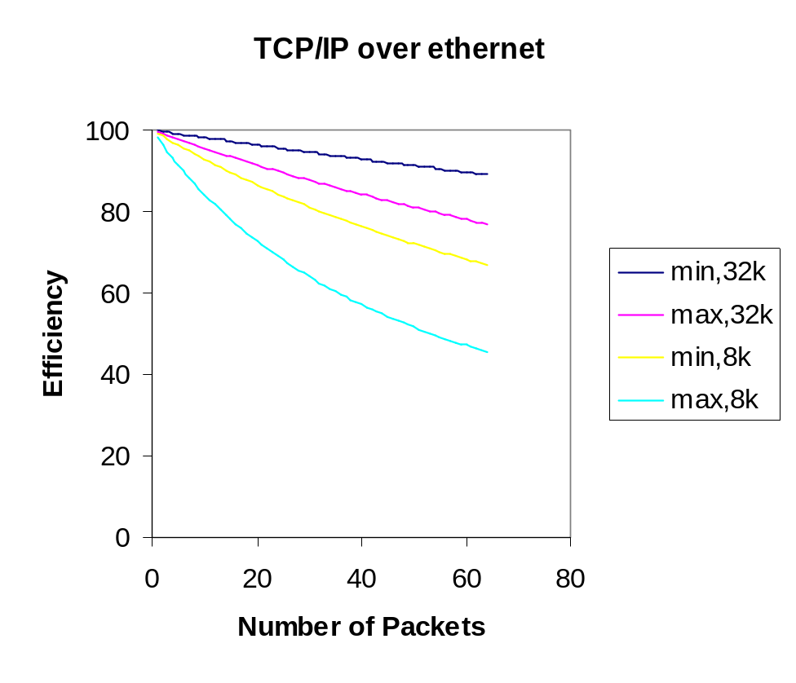
Rule 2
Reduce packet count in a session
  Every packet has an overhead of header information
  Send D bits of information in N packets
  Packet has a header of length H
  Total number of bits sent is D+NH
  Efficiency is D/(D+NH) = 1/(1+NH/D)
Notes:
Rule 2 says that data should be sent in as large a packet as possible. This is simply in order to reduce the overhead of packetisation.
Consider sending data using TCP/IP over an ethernet. The overhead per packet can be anything from 62 bytes to 150 bytes. In the graph the efficiency is shown for the minimum and maximum combined header lengths for the transfer of a 32kbyte file and an 8 kbyte file.

Slide 8
Rule 3
Minimise context switches
  to do with the way operating systems work
  each application, including the OS, runs in its own memory space
  this could be particularly disastrous if disk virtual memory is involved
  cache flushing reduces performance
  can be a major problem even on high performance machines
Notes:
Rule 3 really concerns the design of software which implements the network protocols. It stems from the way most operating systems handle multiple applications. In order to have several programs running at once the operating systems make use of program spaces, each one allocated to a particular application. When a switch between them occurs there is inevitably some overhead, for example saving register configurations. Most modern computers make great use of caching to improve speed of memory access and this fails immediately after an application switch as the cache no longer contains relevant memory locations.

Slide 9
Rule 4
Minimize copying
  Requires memory access which is generally much slower than instruction execution
  Multiple copying can occur when data is passed between different processes
  Even a Cray computer can be slowed down so much that it can’t keep a fast ethernet full
Notes:
Copying data within memory can seriously slow down a machine. Memory access times are generally much longer than the time to execute an instruction. If a packet were copied between different processes running in each layer then four or five separate copies may occur.
Even a machine like a Cray can be reduced to the level of a pocket calculator if too many copies are performed. This observation has lead to the development of ‘light’ protocols which are suitable for achieving high throughput but without much functionality.

Slide 10
Rule 5
Delay is dominated by processing
  Even when it isn’t there is nothing you can do about it as the speed of light is a universal constant
Bandwidth
  increases peak speed
  does not affect the delay of a single bit
  can reduce message delay, for N bit message, bandwidth B
  message time is 2L/v+N/B
Notes:
This rule is more of a warning. Increasing the physical layer bandwidth does nothing for the physical delay. In most systems the total delay is dominated by the processing time in the various routers and end machines.
Increasing the bandwidth of a link can increase the peak throughput available. Tannenbaum comments that doubling the bandwidth does nothing for the delay. At the single bit level, he is right but consider the desire to transmit an N bit message over a link with bandwidth B, length L and propagation speed v. The time taken for the end of the message to arrive is of order 2L/v+N/B. So a very long message might be dominated by the transmission time rather than the propagation time and in that case increasing the bandwidth could lead to a reduction in the message transmission time.

Slide 11
Rule 6
Congestion
  avoid it if at all possible
  when it occurs, there is a temporary increase in traffic as the network tries to reduce the load
  packets are discarded causing re-tranmission
Notes:
Congestion is pure bad news and is best avoided if at all possible. Remember that under congested conditions network throughput typically decreases with an increase in load. As the network has to take some positive action to try and reduce the congestion this means that there will be a temporary worsening of the situation as more control packets are generated.
Congestion causes packet loss which wastes bandwidth at precisely the time the network needs it most.

Slide 12
Rule 7
Timeouts
  avoid if possible since they cause repeated transmissions
  choose timeout values that are conservative
    waiting a little longer is friendly
    constantly re-transmitting unnecessary packets is not
Notes:
Timeouts are another potential cause of wasted bandwidth. They are necessary to cope with errors on the network but they do lead to repeated transmissions which are wasteful if not necessary. The choice of timeout value is very important and, as we have seen, is layer dependent. By setting the timeouts a little conservatively we may wait a little longer but this is better than wasting bandwidth by constantly re-transmitting packets which would have been successfully received.

Slide 13
Summary
Most of the problems are software related
Need to use efficient design
  e.g. Order CASE statements by likelihood
  only re-compute packet fields which can change during a session
Notes:
Most of the design rules are related to issues of protocol implementation in software. It is therefor important to use an efficient design for the software.
Examples of good design are:
CASE statements should be ordered by likelihood of occurrence. When they are compiled they are usually tested in the same sequence as written. Thus if the most likely condition to occur is at the end of the list it will only be reached after all the other conditions have failed.
Don’t compute everything afresh every time. Most of the fields in protocol headers remain the same during a session and these can be precomputed when the session is initiated.
Actually, these are just good design rules which apply to any form of software.

Slide 14
Next Lecture
Network Security
  encryption
    ciphers
    one time pad
    DES
    Public Key
  authentication
  signatures
Notes:
In the next lecture we look at the issues related to Network Security.

